Slide 1
CS670 Phase 2 Group 9 Mass Housing Project
Pratiksha More
Maitreyi Ratnakar
Prathamesh Patel

Slide 2


Overview
Data preprocessing
Applying classifiers
False prediction analysis
Conclusion

Slide 3
Data Preprocessing
Use 5 Year Training Set from the available data and predict the Financial Rating Letter Grade after 5 years.
Removing non-usable data based on rm_key values.
Selecting features and applying classifiers.

Slide 4
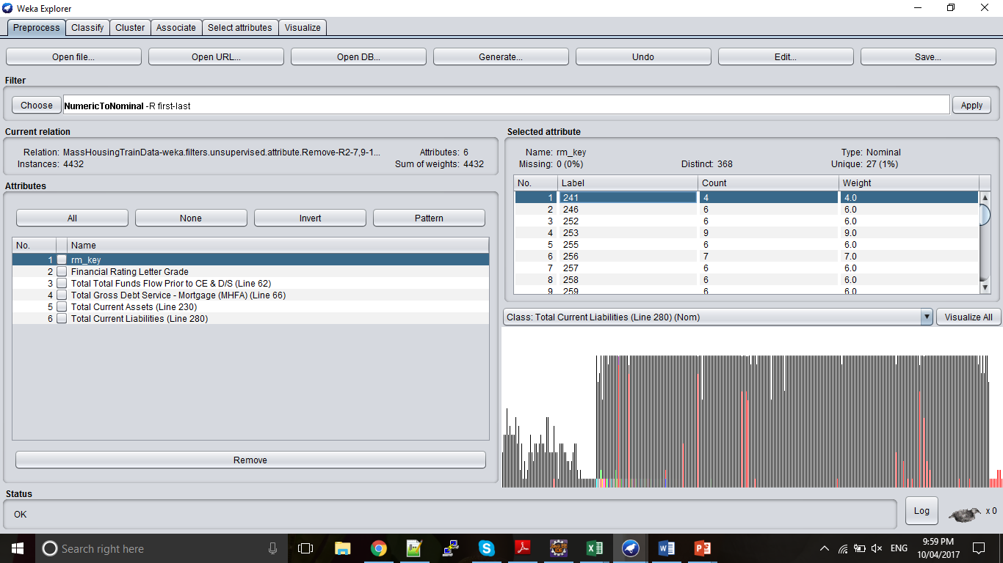
Rm_key count :

Slide 5
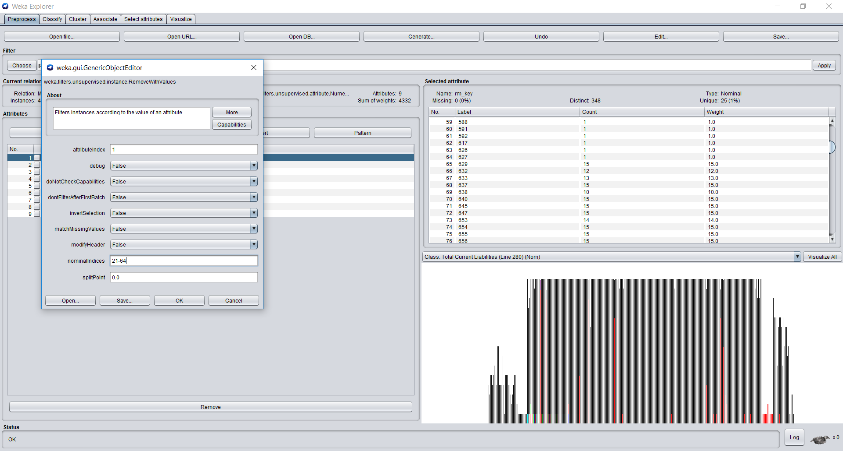

Slide 6
InfoGainAttributeEval
InfoGainAttributeEval : Evaluates the worth of an attribute by measuring the information gain with respect to the class. -M treat missing values as a separate value.
-B just binarize numeric attributes instead of properly discretizing them.
Ranker :
Ranks attributes by their individual evaluations.
generateRanking -- A constant option. Ranker is only capable of generating attribute rankings.

Slide 7
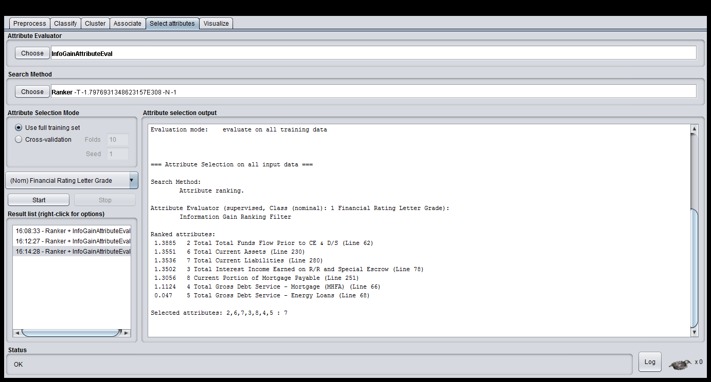

Slide 8
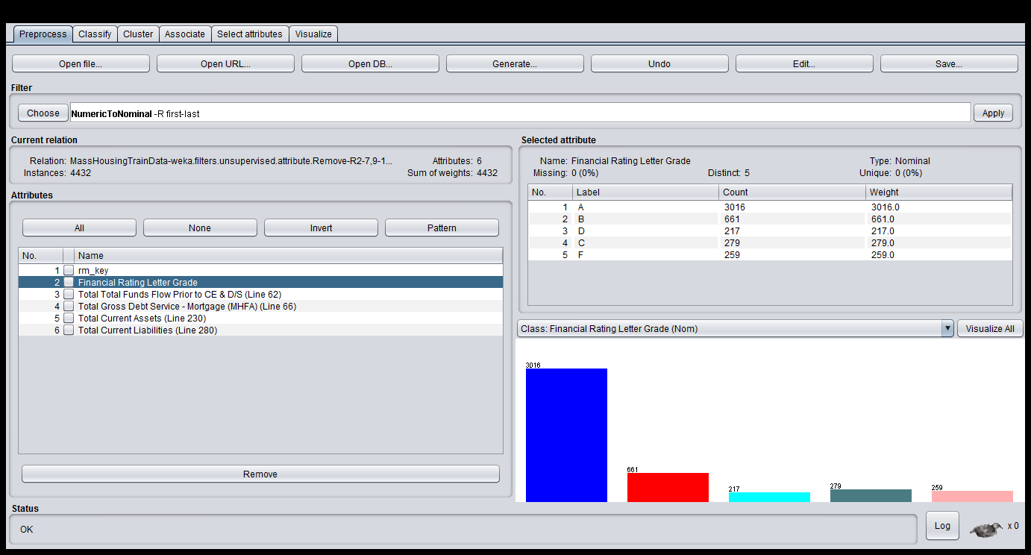

Slide 9
IBK Classifier

Slide 10
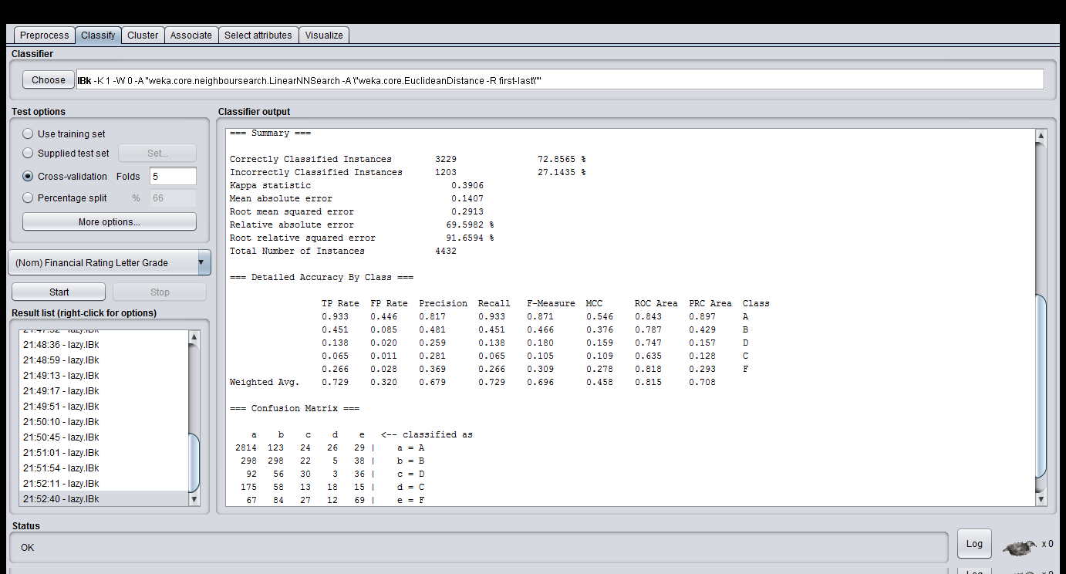

Slide 11
False predictions:
Total data : 4332
Correctly Classified Instances 3229 72.8565 %
Incorrectly Classified Instances 1203 27.1435 %
a b c d e <-- classified as
2814 123 24 26 29 | a = A
298 298 22 5 38 | b = B
92 56 30 3 36 | c = D
175 58 13 18 15 | d = C
67 84 27 12 69 | e = F

Slide 12
Analysis

Slide 13
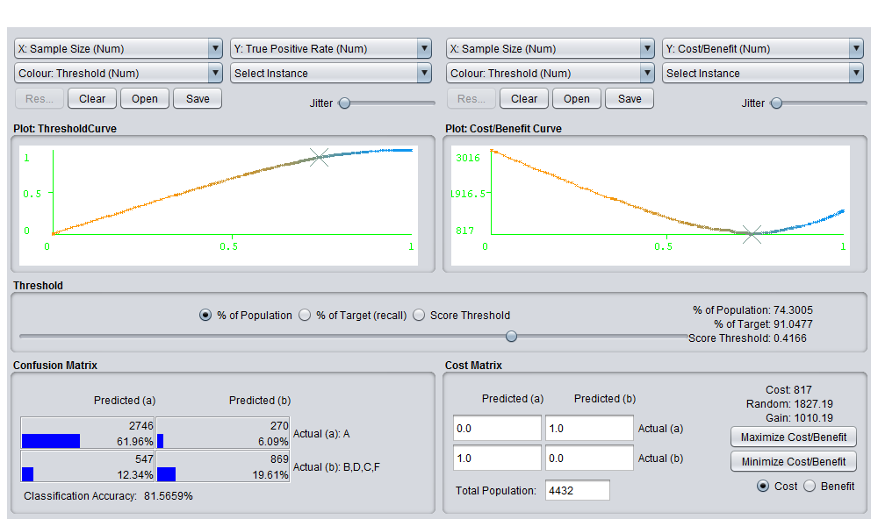

Slide 14
Conclusion:
Phase: 0
Total false positives: 444.0
Total Prediction Accuracy: 72.79411764705883
Total A's: 1142.0, Correctly Predicted A's: 833.0, Accuracy: 72.94220665499124
Total B's: 231.0, Correctly Predicted B's: 170.0, Accuracy: 73.5930735930736
Total C's: 105.0, Correctly Predicted C's: 79.0, Accuracy: 75.23809523809524
Total D's: 80.0, Correctly Predicted D's: 57.0, Accuracy: 71.25
Total F's: 74.0, Correctly Predicted F's: 49.0, Accuracy: 66.21621621621621

Slide 15
Phase 1:
Total false positives: 473.0
Total Prediction Accuracy: 71.65967645296585
Phase 2:
Total false positives: 497.0
Total Prediction Accuracy: 70.8162066940693
Phase 3:
Total false positives: 464.0
Total Prediction Accuracy: 73.16367842683633
Phase 4:
Total false positives: 508.0
Total Prediction Accuracy: 71.0376282782212
Phase 5:
Total false positives: 510.0
Total Prediction Accuracy: 71.63515016685206

